Slide 1
Global Migration 1750 - 1900
Consequences and reactions

Slide 2
Key Concept : Global Migration: 1750-1900
Migration patterns changed dramatically throughout this period, and the numbers of migrants increased significantly.
These changes were closely connected to the development of transoceanic empires and a global capitalist economy.
In some cases, people benefited economically from migration, while other people were seen simply as commodities to be transported.
In both cases, migration produced dramatically different societies for both sending and receiving societies and presented challenges to governments in fostering national identities and regulating the flow of people.

Slide 3
I. Changes in Demography
Migration was influenced by both industrialized and un-industrialized production, and presented challenges to existing patterns of living.
  A. Changes in food production and improved medical conditions contributed to a significant global rise in population.
  B. Because of the nature of the new modes of transportation, both internal and external migrants increasingly relocated to cities. This pattern contributed to the significant global urbanization of the nineteenth century.

Slide 4
II. Reasons for Migration
A. Many individuals chose freely to relocate, often in search of work.
B. The new global capitalist economy continued to rely on coerced and semi-coerced labor migration.
Examples of coerced and semi-coerced labor migration:
• Slavery (Trans-Atlantic trade ended legally in 1802, but shipments continued illegally until 1867)
• Chinese and Indian indentured servitude
• Convict labor
C. While many migrants permanently relocated, a significant number of temporary and seasonal migrants returned to their home societies.

Slide 5
III. Consequences and Reactions
The large-scale nature of migration, especially in the nineteenth century, produced a variety of consequences and reactions to the increasingly diverse societies on the part of migrants and the existing populations.
A. Due to the physical nature of the labor in demand, migrants tended to be male, leaving women to take on new roles in the home society that had been formerly occupied by men.
B. Migrants often created ethnic enclaves in different parts of the world which helped transplant their culture into new environments and facilitated the development of migrant support networks.
C. Receiving societies did not always embrace immigrants, as seen in the various degrees of ethnic and racial prejudice and the ways states attempted to regulate the increased flow of people across their borders.

Slide 6
Indentured Servitude

Slide 7
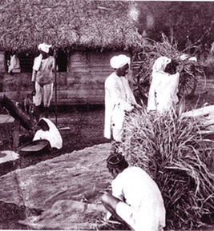
Indentured Servitude
During the eighteenth and early nineteenth centuries, the system of indentured servitude was revived in Europe.
Indentured servitude is a form slavery in which the servant enters into a labor agreement willingly, by contract, and works for a specified number of years with pay, housing, and food supplied.
Abolition of the slave trade and British involvement in India were among the reasons for the revival of indentured servitude.

Slide 8
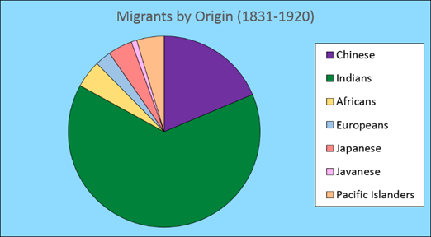

Slide 9
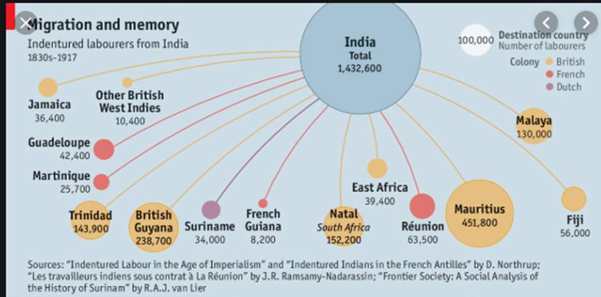

Slide 10
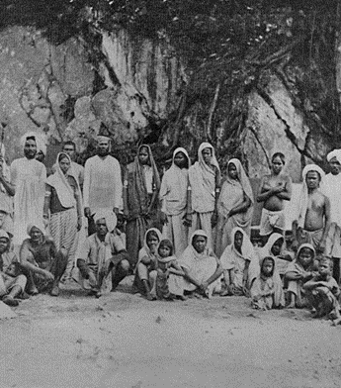
Indian Indentured servants on a sugar plantation in Trinidad

Slide 11
Ethnic Enclaves

Slide 12
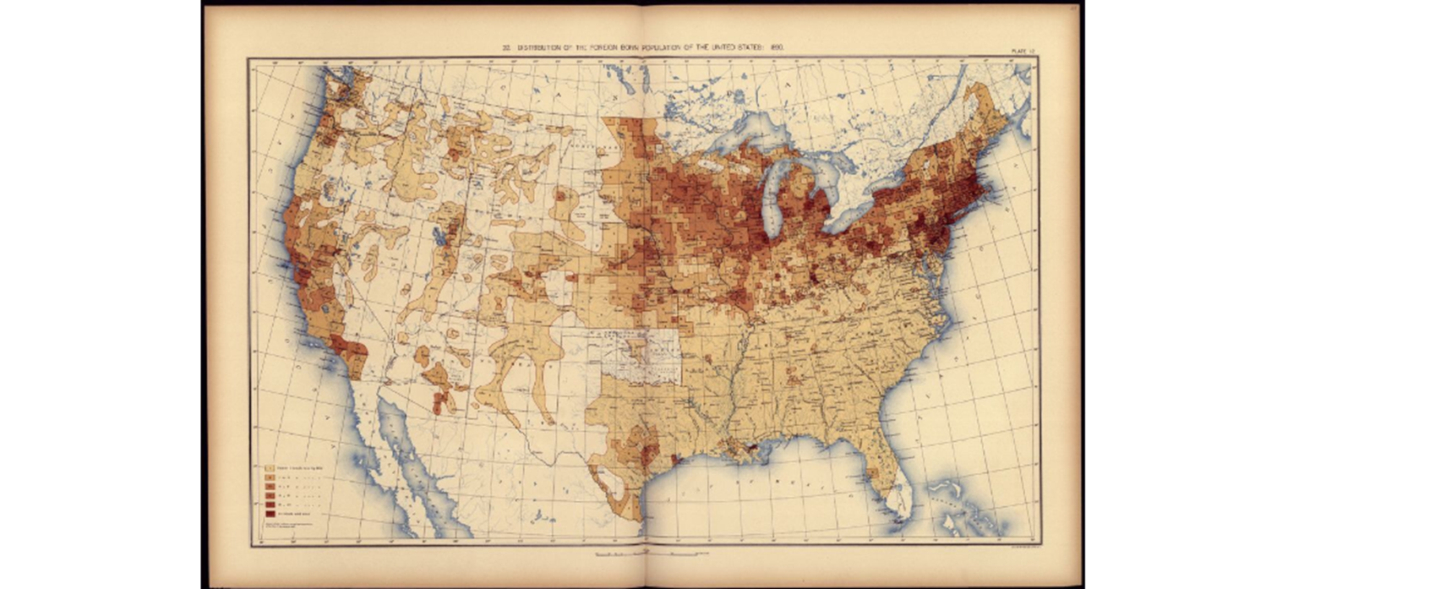
Distribution of Foreign-Born Population, United States. Census office. 11th census, 1890

Slide 13
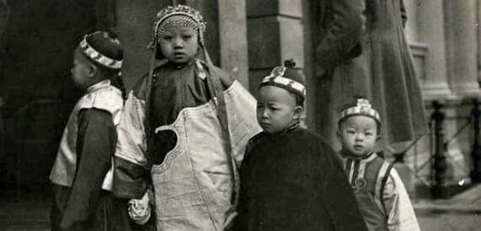
Children in San Francisco’s Chinatown, around 1900

Slide 14
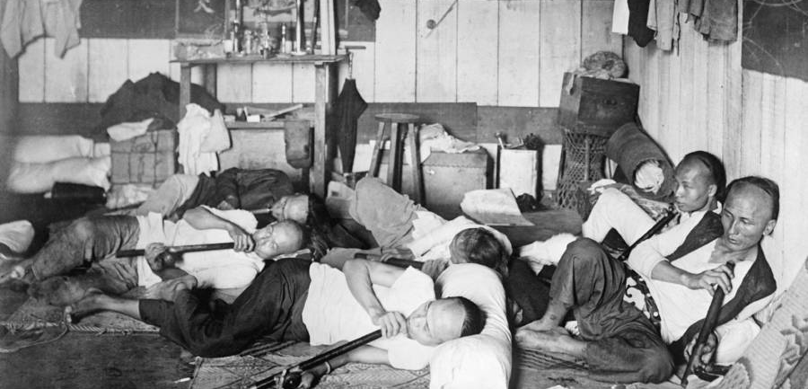
Opium den in Chinatown, New York, 1926

Slide 15
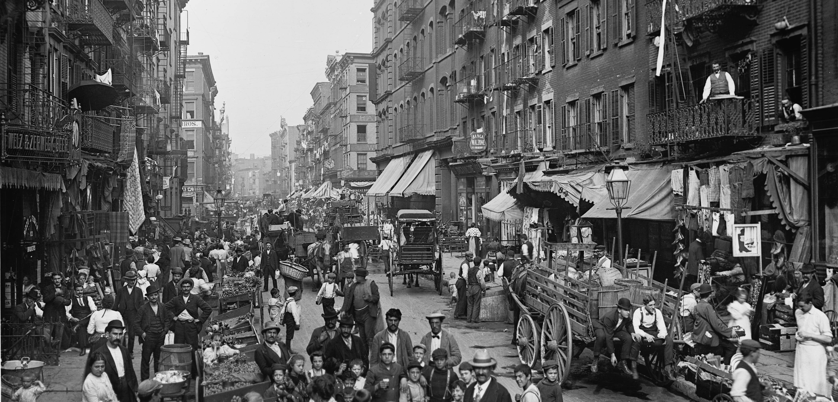
“Not a word of English is heard — only a rough, guttural Italian” Little Italy, New York, 1898

Slide 16
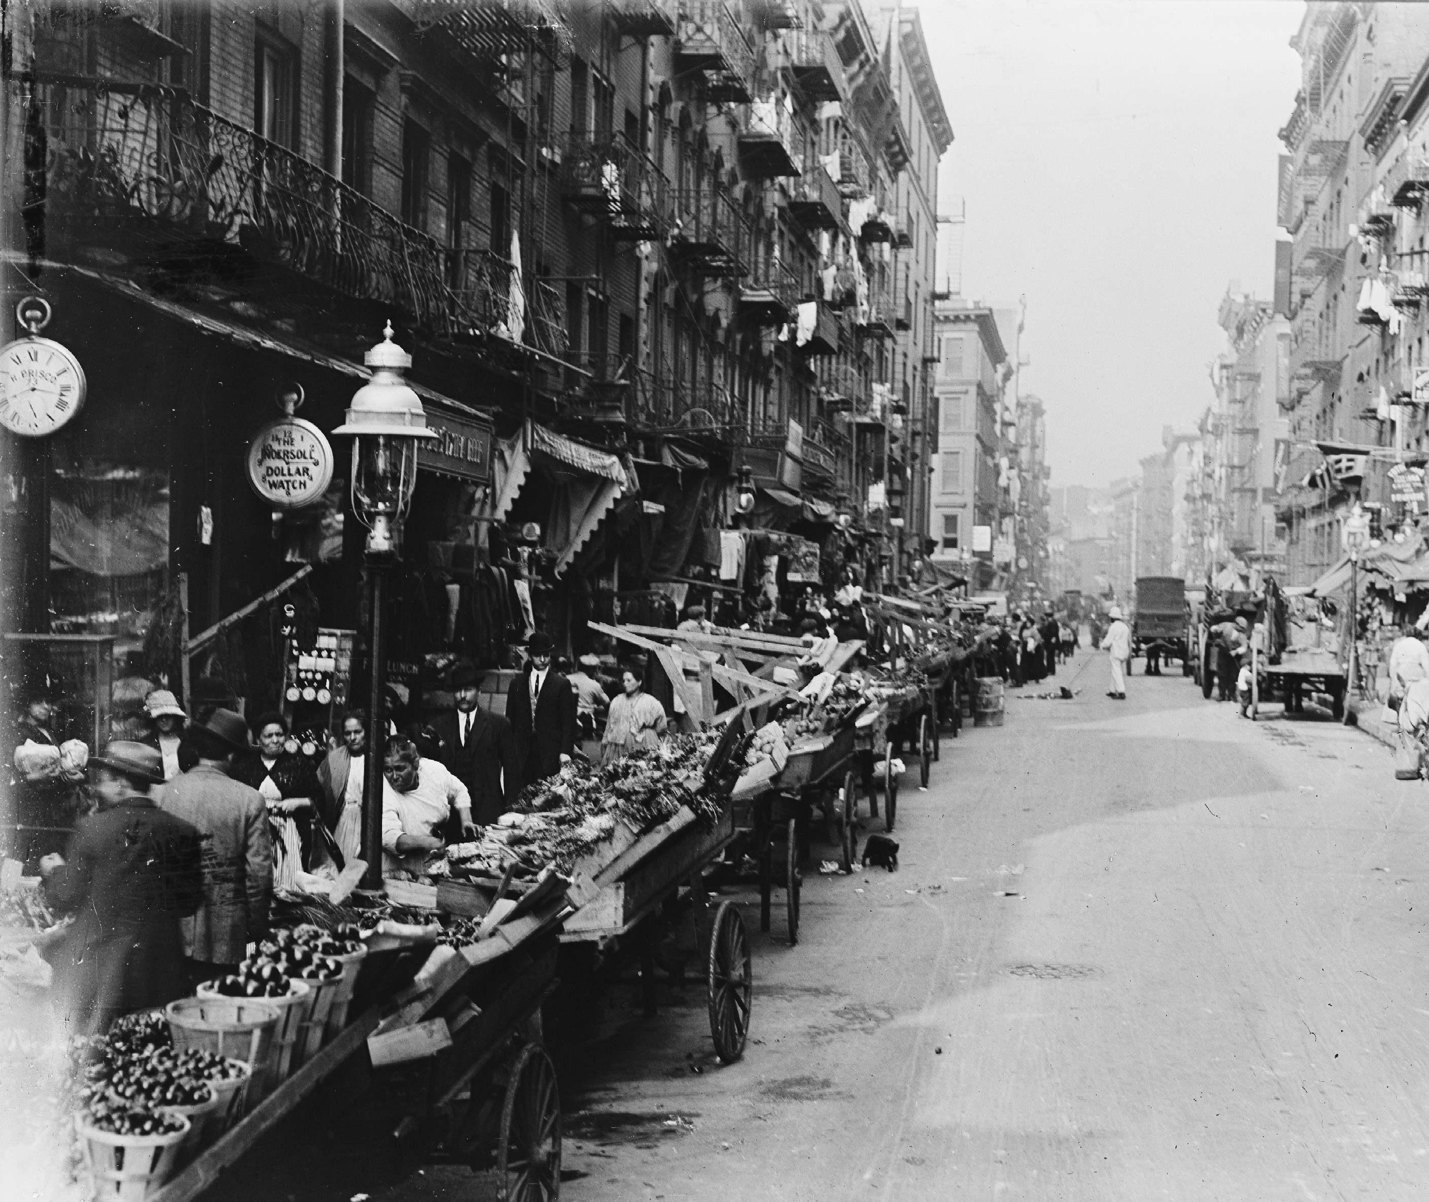
New York’s Little Italy Described In 1898
Mulberry St., here at its southern end, is narrow, dark, and dirty. Six-story tenements, whose unwashed windows scarcely disclose any evidence of the lamp-light within, rise in a solid wall on either hand. Their first floors are occupied by shops of various kinds—all dark now, but blurs of red and yellow light at each corner, and once or twice in the middle, of every block, show that the saloons are still open. …”It is not much after ten o’clock, and plenty of people are in the street; if it be one of the hot summer evenings, everybody is out, half of them asleep on the trucks, or in door-steps, or on the cellar doors, where the mothers have brought pillows, or maybe a mattress, for their children to lie upon; and there they will sleep all night rather than stifle inside those awful hives of neglected humanity.”

Slide 17
Ethnic and Racial Prejudice

Slide 18
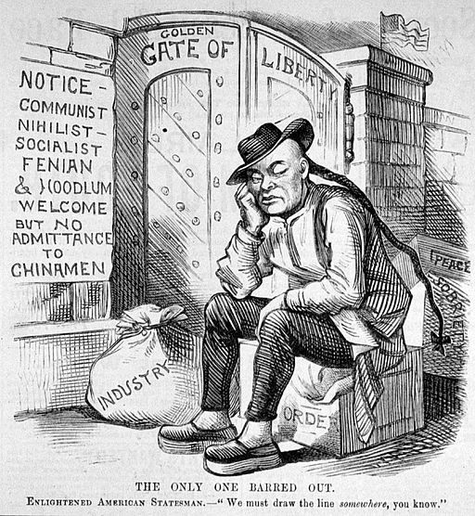
Cartoon from the Enlightened American Statesman commenting on the Chinese Exclusion Act, 1882

Slide 19
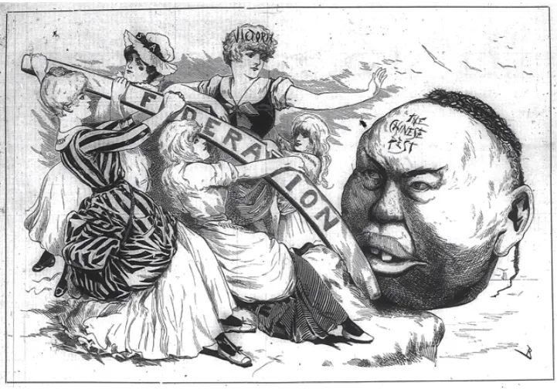
Anti-immigration cartoon with Victoria urging the Australian federation to rid itself of the “Chinese pest,” Melbourne Punch, 1888.

Slide 20
The influential Encyclopedia Britannica reflected the ‘wisdom’ common among English-speaking Australians, 1890
A Chinaman is cold, cunning and distrustful; always ready to take advantage of those he had to deal with; is extremely covetous and deceitful, quarrelsome, vindictive, but timid and dastardly. A Chinaman in office is a strange compound of insolence and meanness... (with) a total disregard for the truth.

Slide 21
New Orleans lynchings
In the 1890s, thousands of Italians arrived in New Orleans each year. Many settled in the French Quarter, which by the early 20th century became known as "Little Sicily."
The mayor complained that the city had become attractive to "...the worst classes of Europe: Southern Italians and Sicilians...the most idle, vicious, and worthless people among us." He claimed they were "filthy in their persons and homes" and blamed them for the spread of disease, concluding that they were "without courage, honor, truth, pride, religion, or any quality that goes to make a good citizen."
The March 14, 1891, New Orleans lynchings killed 11 Italian Americans in New Orleans for their alleged role in the murder of police chief David Hennessy after some of them had been acquitted at trial. It was one of the largest single mass lynchings in U.S. history

