Slide 1
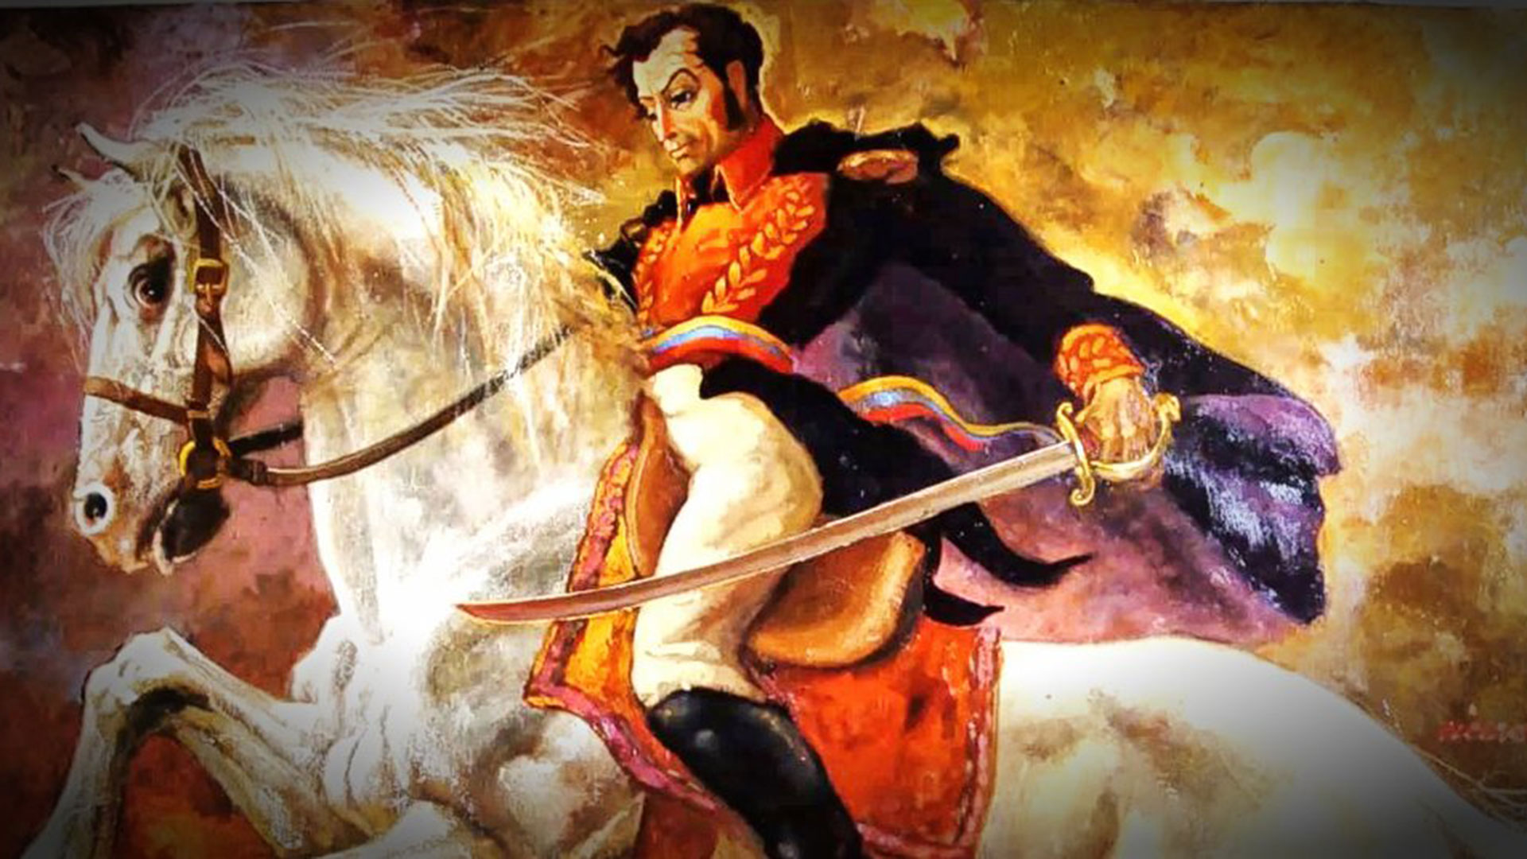

Welcome to APWH Modern!
Important:
Due Tomorrow: Snapshot II and all SPECT Charts
If you missed Test 3 or reading Quiz 15, make-up is Friday at the
beginning of lunch.
Keep your mask above your nose and on your face at all times.

Slide 2

12 - 16 - 2021
Learning Target:
I can examine the South American Revolutions.

Slide 3

Q.O.T.D.
1. Who are the social classes involved in the Mexican Independence movement?
2. What priest led an army across Mexico, demanding freedom and land redistribution?
3. Who took over after #2 was killed?
4. Who ended up crowning himself emperor of Mexico?
5. Who took over the government in the end?
6. Who was the main cause of the Mexican Revolution?

Slide 4

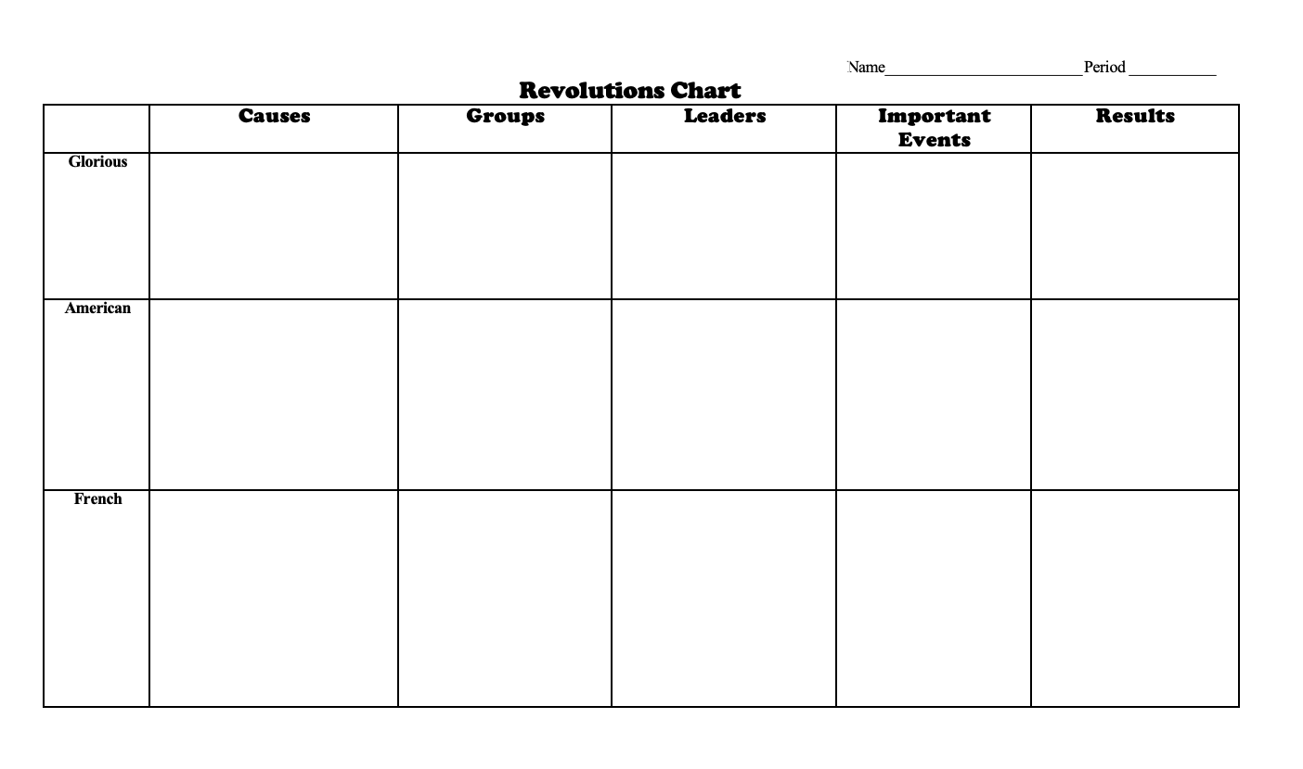
South American Revolutions

Slide 5
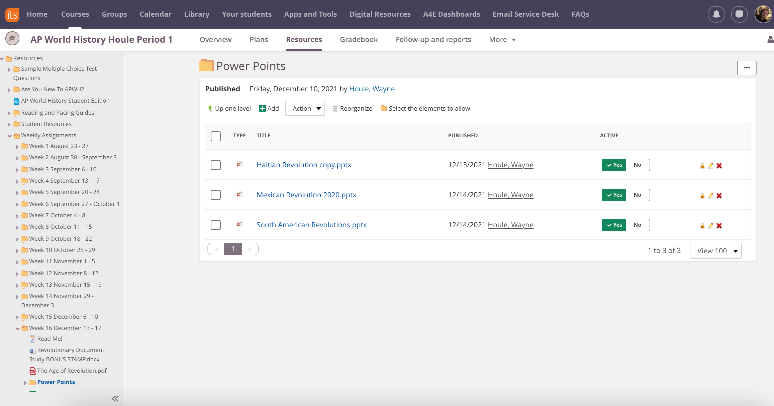

Slide 6

Do Now
Learning Target: I can graph out important components of the Brazilian Revolution.
QOTD: Open-ended question – why do so many of the revolutions we have looked at over the past week end with relatively little progress? (I.E. Monarchy, upper-class rights)
Or – why do you think so few rights are granted to the lower classes during this time period? Think about it…..

Slide 7
SOUTH AMERICA

Slide 8
Commonalities South American Revolutions
Mainly led by creoles (Whites born in the Americas)
  educated in Europe
  cognizant of “philosophes”
  desired equal rights with native Europeans
  had little affinity to the Amerindians or slaves
Napoleonic wars cause ties to weaken with colonies

Slide 9
The Peninsular War (1807–1814)
Military conflict between Napoleon’s army and Spain for control of the Iberian Peninsula during the Napoleonic Wars.
French and Spanish armies invaded and occupied Portugal in 1807
France turned on Spain, previously an ally, and invaded in 1808
The war on the peninsula lasted until Napoleon was defeated in 1814.
The fighting had repercussions in Latin American colonies

Slide 10
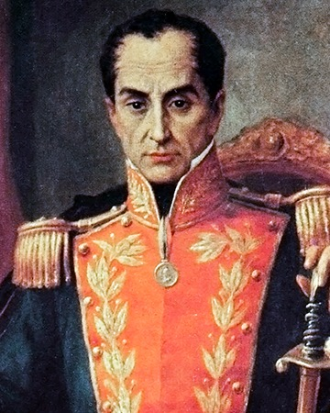
Liberation of South America
In the north, starting in 1807, led by Simón Bolivar, a Creole educated in Europe, Wrote Manifesto of Cartagena - a cry for revolution
Bolivar did not support rights for lower classes in Venezuela…they will force him out to Colombia

Slide 11
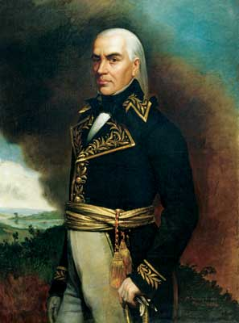
Independence
In 1808, the Spanish Empire trembled when Napoleon conquered the Iberian peninsula and appointed his brother ruler of Spain
Bolívar joined a revolutionary group that expelled the Spanish governor from Venezuela.
The ruling junta sent Bolívar to England in search of assistance.
In 1811, Venezuela declared its independence, and early the following year Miranda, a prominent Venezuelan nationalist, became head of the revolutionary government

Slide 12
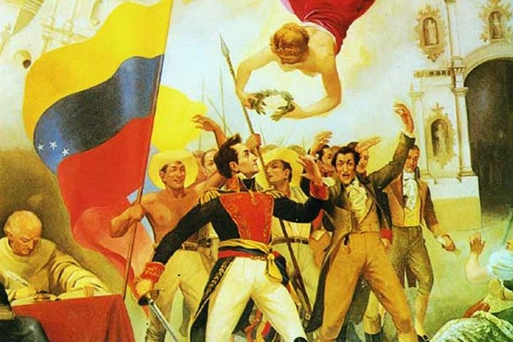
Simon Bolivar: El Liberator
A split developed in the revolutionary leadership, however
After journeying to New Granada (Colombia), Bolívar planned another attack and in August 1813, led an army triumphantly into Caracas, proclaimed the region a republic
He was made its leader with the title of "Liberator."
He had not, however, secured his position, and in 1814, the Spanish, supported by Venezuelan llaneros, or cowboys, defeated the Liberator, who fled to Jamaica

Slide 13
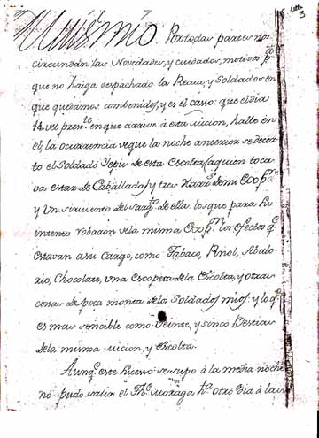
The Jamaica Letter
Bolivar, in exile in Jamaica, wrote a letter explain his political aspirations for South America
  Inspired by Enlightened ideas
Anxious to continue the fight, he obtained weapons and money from Haiti and in March 1816, sailed for Venezuela
Upon returning to Venezuela Bolivar gained support from patriot guerilla bands, the llaneros (who had changed sides) , British merchants and soldiers living in South America.

Slide 14
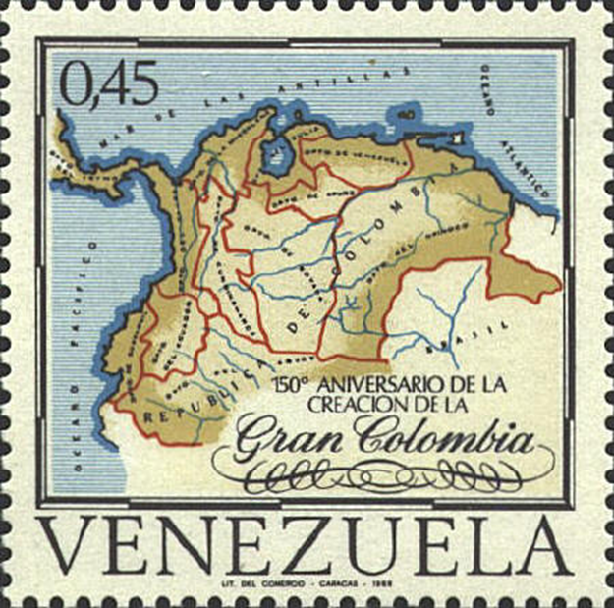
Bolivar believed in a ‘Gran Colombia”

Slide 15
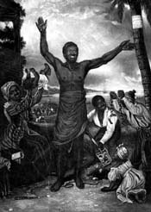
Republic of Colombia
At the Angostura Congress (1819) established Republic of Colombia Bolivar presented a Constitution that:
  Gave Bolivar dictatorial powers
  Abolished slavery (gets British and Haitian support)
  Distributed land to soldiers
  Appointed a president with royal powers
  Created a hereditary Senate (like British House of Lords)
  Voting restricted to property owners

Slide 16
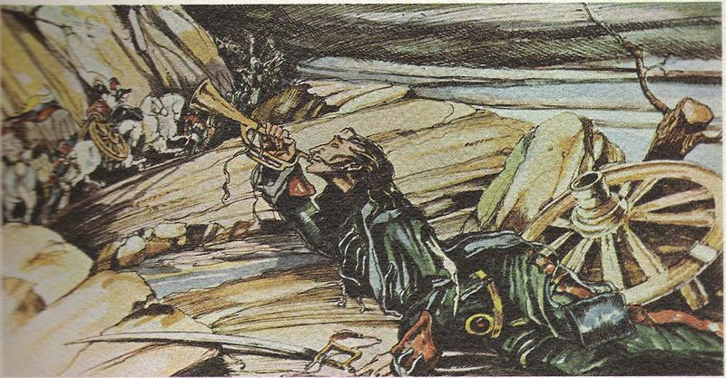
Bolivar’s army
Crossed the vast central plains and then the Andes during the rainy season and made a surprise attack on Bogotá.
His much depleted force routed the royalists’ main forces forcing the Spaniards and loyalists to flee from Bogotá, 1819
1821, Bolívar won the Battle of Carabobo, and Caracas fell
Bolívar next went south and conquered the province of Quito.

Slide 17
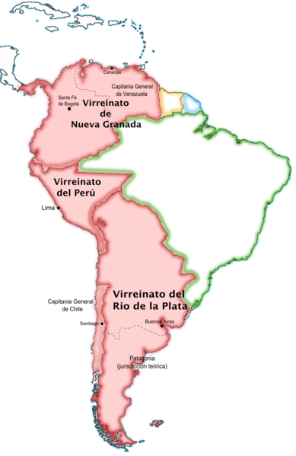
Liberation of southern South America
Creoles in southern South America rose against the Peninsulares.
There were divisions between liberal and conservative Creoles.

Slide 18
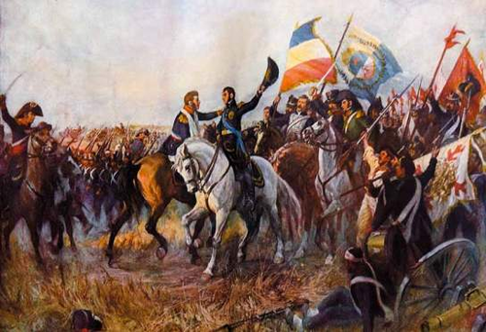
Liberation of Argentina
Jose de San Martín
  Left the Spanish military in 1812 and returned to Argentina where he allied with the rebels in Buenos Aires who demanded independence from Spain.

Slide 19
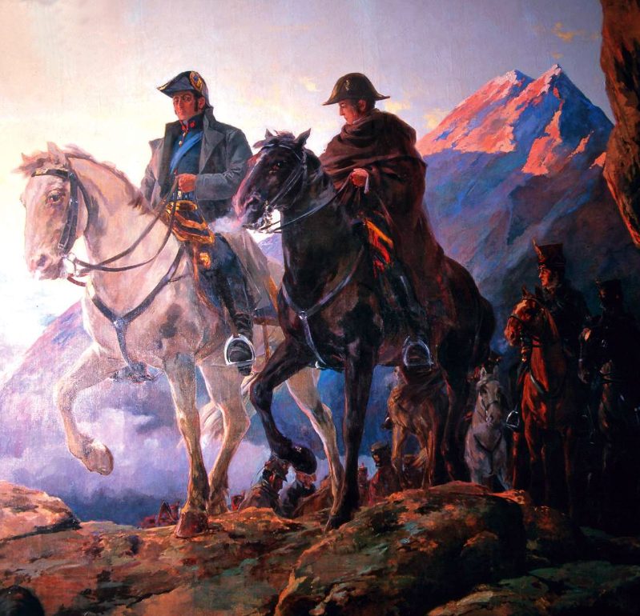
Chilean Independence
  Chile’s Creole leader, Bernardo O’Higgins, had been defeated by Royalists.
  San Martín crossed the Andes and defeated Spanish in Chile
    Ended tribute and frees children of slaves.
    Placed O’Higgins back in control.

Slide 20
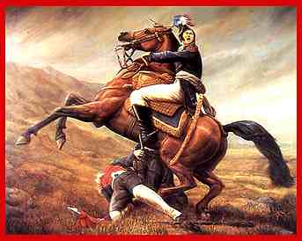
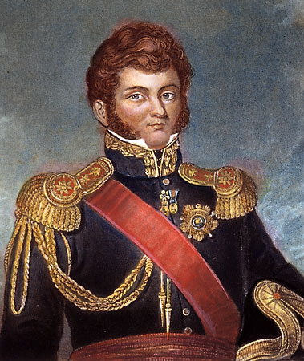
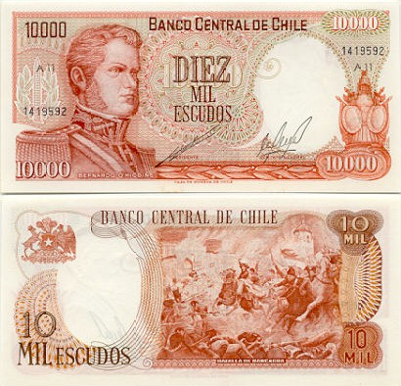
Bernardo O’Higgins
He is seen as the father of Chile

Slide 21
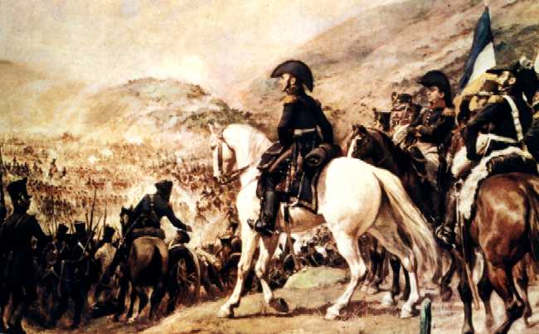
Meanwhile in argentina
New government in Argentina promises:
  Abolition of mita
  Abolition of encomienda
  Abolition of nobility
  Abolition of the Inquisition

Slide 22
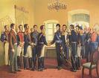
Bolivar and San Martín met in Guayaquil, Peru
Bolivar
San Martín
Wanted coast of Peru
Wanted a republican oligarchy
Assumed singular leadership of revolution in South America.
Wanted coast of Peru
Wanted a monarchy
Retired from public life and dies in obscurity in France.
My lips are sealed
What was said at this meeting remains a mystery.

Slide 23
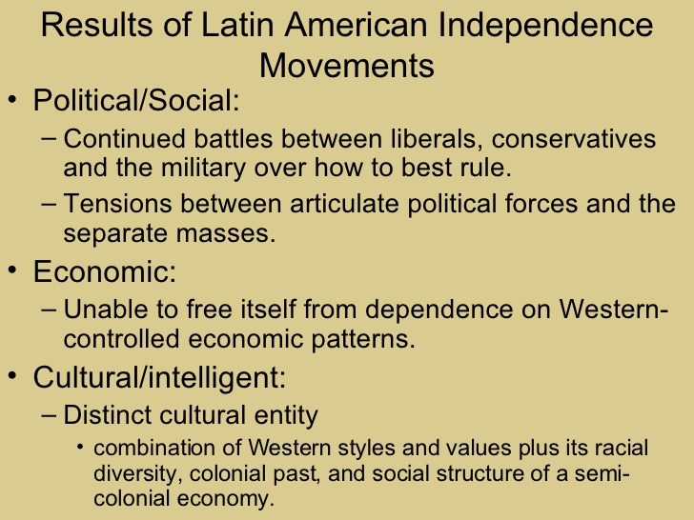
The Real Results
Oppression of slaves and natives Americans continued
Caudillos (military dictators) gained power and forged alliances with landowners
Liberty was only a banner achieved at the expense of the poor, ethnic and mixed populations.

Slide 24
BRAZIL

Slide 25
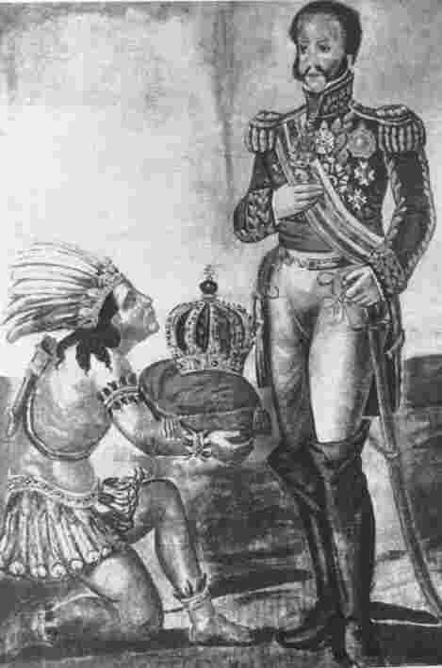
Brazilian Independence
1808-1822
Relatively bloodless
Conflict between Mazombos (Creoles) and Reinois (Peninsulares)

Slide 26
Causes of Discontent
The Portuguese government heavily regulated the trade, manufacturing, and commerce of its most important colony. (mercantilism)
The Crown also taxed mineral resources, commerce, and luxury goods
It awarded contracts to tax farmers to collect as much as they could in return for a fixed payment to the Crown.
To ensure that the colonists concentrated on producing mineral wealth and sugar that would benefit Portugal, the monarchy refused to allow any manufacturing in Brazil

Slide 27
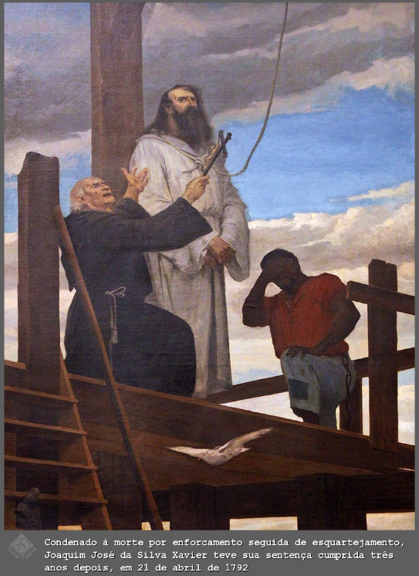
Early Events
Planters, merchants, and clergymen in Minais Gerais organized a movement designed to win Brazilian independence.
The governor of the province discovered the plot and quickly executed the movement's leader, José da Silva Xavier, "the Toothpuller."
Other insurrections broke out in Rio de Janeiro in 1794, in Bahia in 1798, and in Pernambuco in 1801.
All of these rebellions were repressed before they could seriously threaten the monarchy

Slide 28
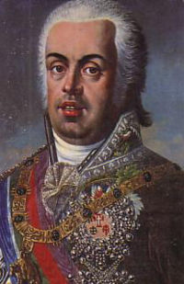
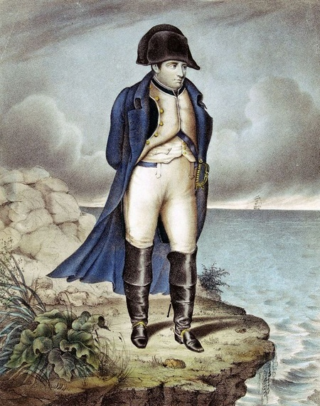
Causes of Brazilian Independence
Royal family fled Portugal, 1808 when Napoleon invaded
With the seat of the Portuguese government in Rio de Janeiro, many of the old restrictions on trade and commerce disappeared.
Most important, the government opened Brazil's ports to British trade and merchants, manufacturing was encouraged, schools and institutions of higher education were constructed, and a new army was formed.
Va t'en
King João VI

Slide 29
After Waterloo…
Everything changed again when Napoleon was defeated in 1815.
Many Brazilians were initially optimistic when Portugal granted Brazil coequal status as a kingdom in 1816
In 1820 revolution of 1820 in Portugal with military garrison revolts
Portuguese gradually reconstructed their country and demanded that mercantilism be restored and that King João return to Portugal

Slide 30
Extreme(ish) Events
Both João and his son, Pedro, recognized that too much had changed to return to the days when Brazil was a colony.
When King João left for Portugal, (1821) he advised his son to be ready to seize the crown of Brazil if demands for independence accelerated.
  Portuguese Cortes (parliament) attempted to end reforms in Brazil and told Pedro return to Portugal for “education.”
Under pressure from the Portuguese Cortes and Portuguese troops in Brazil, Pedro issued his "fico" or declaration that "I am staying" on January 9, 1822.

Slide 31
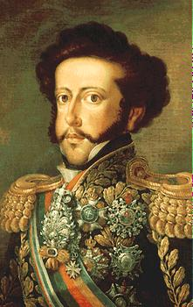
Como é para bem de todos e felicidade geral da nação, estou pronto, diga ao povo que fico!
For the good of everyone and the nation, there is nothing I can say at this point, but I stay.
OR
I have many medals!

Slide 32
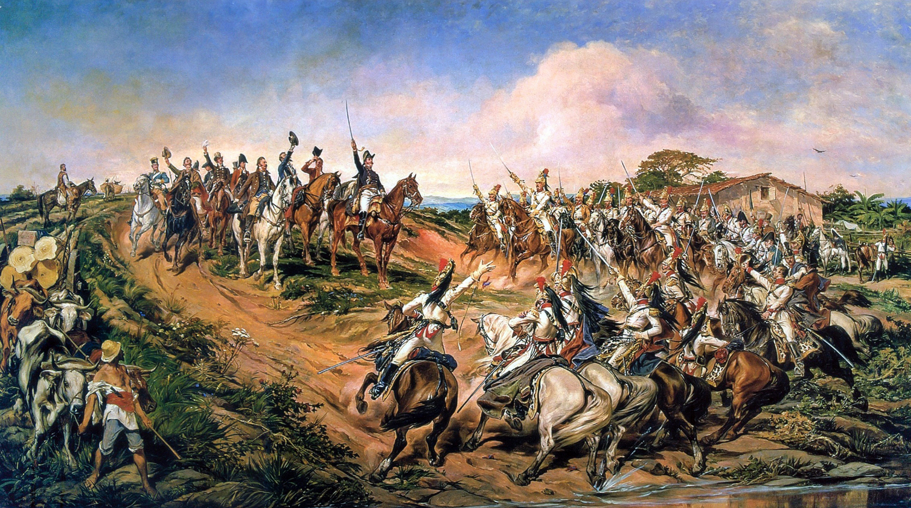
More Extreme(ish) Events
Pedro created a new government with some Brazilian advisors then announced Grito do Ipiranga (Cry of Ipiranga)“ Independence or Death" on September 7, 1822.

Slide 33
Cry of Ipiranga
“Friends, the Portuguese Cortes want to enslave and pursue us. From today on our relations are broken. No ties unite us anymore” [pulling off his blue and white armband that symbolized Portugal]: “Armbands off, soldiers. Hail to the independence, to freedom and to the separation of Brazil”. [unsheathing his sword]"For my blood, my honor, my God, I swear to give Brazil freedom. Independence or death!”.

Slide 34
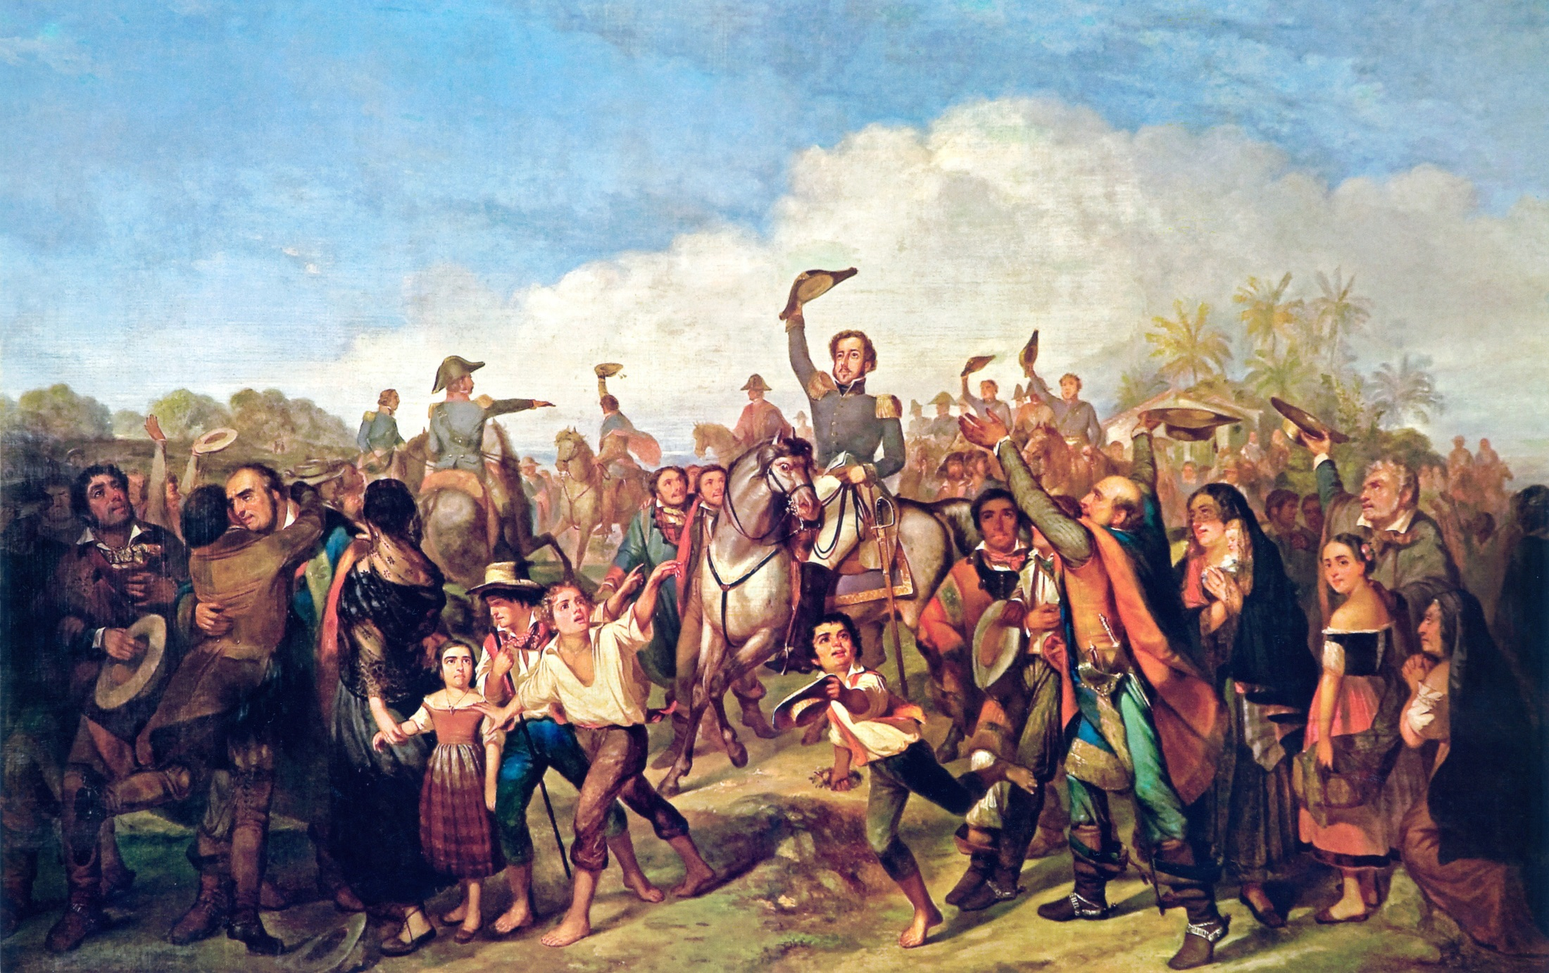

Slide 35
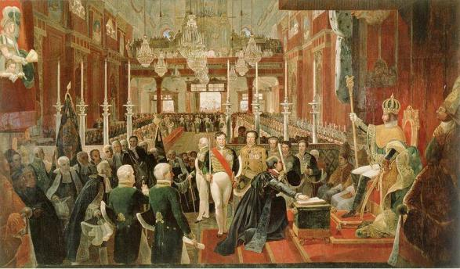
Three months later he was crowned Pedro I and became a more-or-less constitutional Emperor, who, nonetheless, had the power to dissolve the national assembly. assembly

Slide 36
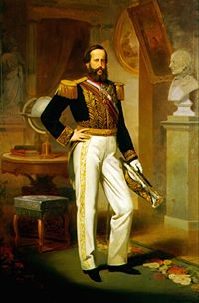
Changes
Pedro directed writing of constitution, 1824
  Emperor had most authority
  Individual freedom & equality before law
  Religious tolerance
Signed treaty with British to end slave trade
  Wealthy slave owners continued practice for another twenty years)

Slide 37
Resisting Independence
Fear of what freed slaves might do slows the process of independence in Brazil.
Slaves could gain freedom by joining the army.

Slide 38
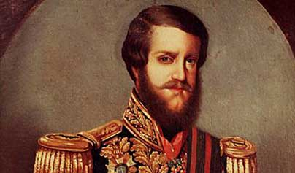
Footnote
  Pedro abdicated 1831(street violence)
  Five-year old son, Pedro II (Pedro de Alcântara João Carlos Leopoldo Salvador Bibiano Francisco Xavier de Paula Leocádio Miguel Gabriel Rafael Gonzaga) nicknamed "the Magnanimous" was the second and last Emperor of Brazil; he reigned for 58 years.
  Brazil was the last nation in the Western world to abolish slavery - 1888
  Brazil became a republic 1889
  For decades was the only stable government in Latin America.

Slide 39
Crash Course
Latin American Revolutions
https://www.youtube.com/watch?v=ZBw35Ze3bg8

Slide 40


Slide 41
To be continued...

Slide 42

Bellaire APWH Modern
Cothran * Kuhleman * Houle
All material in this presentation was created ON OUR OWN TIME and on OUR OWN
EQUIPMENT off of school property. Not to be used without permission.

